Slide 1

Lecture 10: Probability Theory
Artificial Intelligence (CS 131)

Slide 2
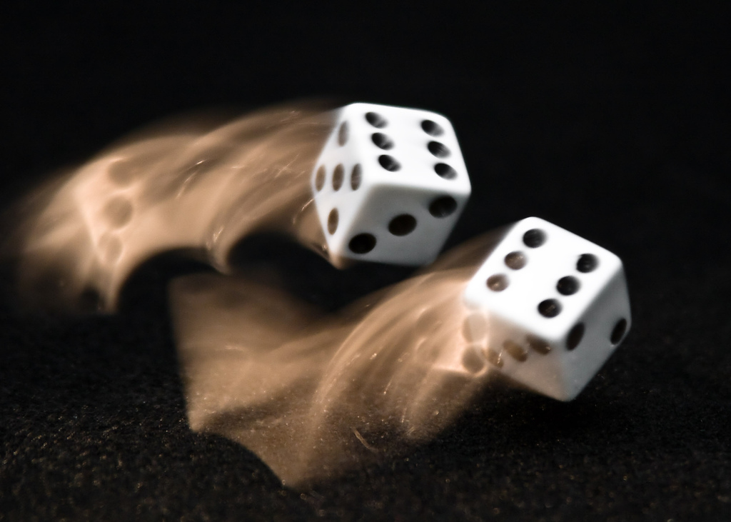
A Problem Involving Games
Two players put money in on a game of chance
First one to certain number of points, P, wins the money
Game is interrupted before either wins, however:
Player one has n < P points
Player two has m < P points
Who wins?

Slide 3
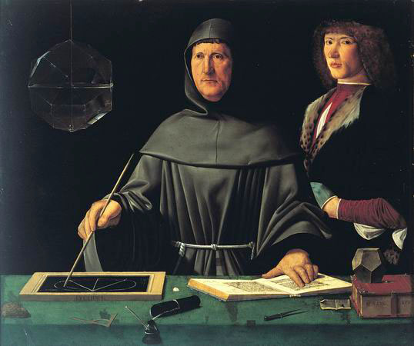
Paccioli’s Solution
Summa de Arithmetica, Geometria, Proportioni et Proportionalita (1487)
Each gets proportion given by points so far, relative to total points by all players
Player with n points gets:
n / (n + m)
Player with m points gets:
m / (n + m)
According to Paccioli, any other solution is simply “preposterous”

Slide 4
Problems for Paccioli: Small Samples
What if we’ve only played one round?
What if we’ve played a few rounds, but there are many more left still to go?
Is it fair that I win all or most of the money if I’ve only won a few games by luck at the start?

Slide 5
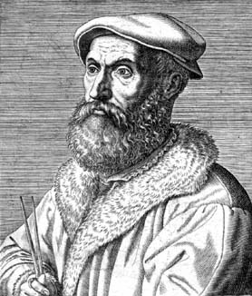
Tartaglia’s Solution
Trattato generale di numeri e misure (1556)
Winner so far gets extra share in proportion to current lead, relative to total needed to win
So if player with n points leads, and P points complete the game, that player gets own half of the money, plus extra bonus, taken out of losing player’s share:
(n – m) / P

Slide 6
The Trouble with Tartaglia: Ignoring Likely Outcomes
Suppose we play to 100 points and the situation is:
Player 1: 80, Player 2: 70?
Player 1:99, Player 2: 89?
Player 1: 15, Player 2: 5?
What’s the difference between these situations?
Depending upon the situation, the current lead may or may not tell us much about how likely we are to win in the future

Slide 7
The Birth of Probability Theory
This “Problem of Points” (among other things) led to creation of probability theory
A realization that it didn’t really matter how many games you had already won
Instead, we want to think about the chance that you are going to win in the future
What was wanted:
An exact measure of how likely something is
A system for calculating with such likelihood measurements

Slide 8
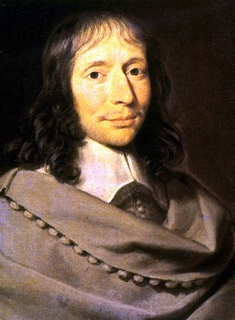
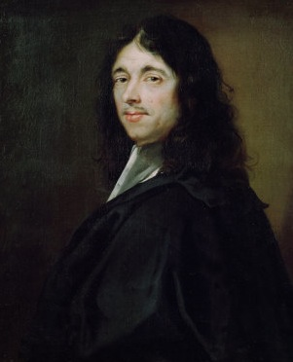
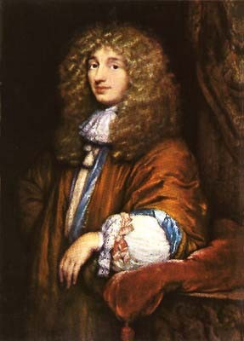
Creators of Probability Theory
Blaise Pascal Pierre de Fermat Christiaan de Huygens
(1623-62) (1629-95) (1601-65)

Slide 9
Sources of Uncertainty
Stochastic environments
players in games who play randomly, random action-effects
Imprecise models
complex systems (weather, real-life games), unknowns and errors in descriptions (Mars Polar Lander)
Noisy data
limited range, obscuring weather, defective sensors
Limitless exceptions to our knowledge
“Mammals have live young,” “Republicans are military hawks”
Many more…

Slide 10
Reasoning Under Uncertainty
Even simple exceptions to rules cause problems for apparently logical reasoning patterns:
“Usually, mammals bear live young”
“Usually, warm-blooded animals are mammals”
“Usually, warm-blooded animals bear live young”
“Usually, people who join the Army are male”
“Usually, female ROTC members join the Army”
“Usually female ROTC members are male”

Slide 11
Probability and Uncertainty
Precise framework for exact reasoning under uncertainty
Allows us to:
Combine multiple pieces of evidence
Update our beliefs as new evidence comes in
Predict what is likely going to happen in the future
Diagnose what is likely to have happened in the past, given the present circumstances

Slide 12
Basic Elements of Probability Theory
Random variable: thing with uncertain outcomes, and its own domain of values, which could be:
Boolean (True/False)
Discrete (countable domains)
Continuous (real-numbered domains)
Outcome: particular setting of a value for some variable
Example: die₁ = 3
Event: a combination of outcomes
Example: die₁ = 3 ∧ die₂ = 2 ∧ die₃ = 6

Slide 13
Random Variables & Outcomes
Notation:
X, Y, Z : individual variables
x, y, z : outcome values from the domain of each variable
We may use more informative names:
StudentXGrade: grade for Student “X”
A, B: possible grade values
Atomic event: particular outcome for a set of variables
Perhaps a single event: StudentXGrade = A
Perhaps a combination:
StudentXGrade = A ∧ StudentYGrade = B

Slide 14
Basic Logical Notation in Play
Logical symbols:
NOT: ¬ A (Event A did not occur)
AND: A ∧ B (Both A and B occur)
OR: A ∨ B (Either A or B, or both, occur)
SOME: ∃x… (Exists at least one x such that…)
ALL: ∀x… (All x are such that…)
Basic logical facts:
Non-contradiction: A ∧ ¬A == False
Excluded Middle: A ∨ ¬A == True

Slide 15
Properties of Basic Events
Mutually exclusive: At most one event can be true
Exhaustive: At least one event must be true
Thus, one (and only one) of the following has to be true, assuming two variables with two values each:
StudentXGrade = A ∧ StudentYGrade = A
StudentXGrade = A ∧ StudentYGrade = B
StudentXGrade = B ∧ StudentYGrade = A
StudentXGrade = B ∧ StudentYGrade = B

Slide 16
Probability Distributions
For any variable and outcome, we have the unconditional probability that it is true:
P(StudentXGrade = A) = 0.78
Distribution: collection of all probabilities for a variable:
P(StudentXGrade) = {0.78, 0.22} [A, B]
We can then calculate the probability of more complex events based on the basic distributions:
P(StudentXGrade = A ∧ StudentYGrade = B) = ?
Where do these basic numbers actually come from?

Slide 17

Subjective Probability
One view: probabilities describe what we believe to be true about the world
How confident we are that something will/won’t happen
Can be based on a number of things (observation of human behavior, expert opinion, polls, etc.)
Question: what do we do if our beliefs are different than those of others?

Slide 18

Objective Probability
Another view: probability distributions reflect reality
Events really do happen with some set probability
If we have an accurate distribution, then our numbers match with how the world is in and of itself
Question: what is the mechanism that makes all of this work?

Slide 19

Frequentist Probability
Another idea: probabilities are based on actual, empirical observation of events over time
We track how many times different outcomes occur, relative to the total number of events seen so far
Potential Issues:
Requires many observations
Unrepeatable/very rare events are hard to put meaningful numbers on
Objectivist view thinks this is just an attempt to learn what is really there in the first place

Slide 20
Basic Axioms of Probability
P(a ∧ b)
P(a)
P(b)
P(a v b)

Slide 21
Using the Axioms
P(¬a)
P(a)

Slide 22
Joint Probability
For random variables {X1, X2, …, Xn} joint distribution gives probability of each possible combination of outcomes
Can be written as a table of values:
 | StudentXGrade = A | StudentXGrade = B
StudentYGrade = A | 0.72 | 0.08
StudentYGrade = B | 0.18 | 0.02
Note: if the table is supposed to represent a proper joint distribution, then the numbers must all sum to 1.0

Slide 23
Marginal Probability
 | StudentXGrade = A | StudentXGrade = B
StudentYGrade = A | 0.72 | 0.08
StudentYGrade = B | 0.18 | 0.02
Given the joint distribution we can get the probability of any outcome by marginalizing: summing all values for which the outcome of interest is true
For example, probability student X gets an A:
Probability that either X or Y gets an A:

Slide 24
Size of the Joint Distribution
How many numbers do we need to specify the full joint distribution in each of the following cases:
Three variables as follows:
StudentGeneration = {First, Other}
StudentYear = {1, 2, 3, 4}
StudentGrade = {A, B, C, D, F}
A set of n binary (2-valued) variables?
A set of n m-ary (m-valued) variables?

Slide 25
Conditional Probability
One of the most important things we do with probabilities involves reasoning from evidence
We don’t always care about the prior (simple) probability that something is true no matter what
Rather, we want to know how likely it actually is given what else we know…
Given a storm warning, how likely is a hurricane?
Given the cards on the table, how likely is my opponent to have a better poker hand than me?

Slide 26
The Product Rule for Conditional Probability
We define the conditional probability of event a, given event b, using the basic rule:
Equivalently, we have the product rule for joint probability (in two different, equivalent forms):
Why are these equivalent? (Follows from basic logic and the basic definition given above.)

Slide 27
Calculating Conditional Probability
Given the following joint distribution:
What is the probability of getting an A if we study 3–5 hours?
What is the probability of getting a B or higher if we study that same amount?
What is the probability that a student who studies less than 3–5 hours doesn’t get an A?
 | StudyHrs = 3-5 | StudyHrs = 1-2 | StudyHrs = 0
Grade = A | 0.12 | 0.08 | 0.02
Grade = B | 0.16 | 0.14 | 0.04
Grade = C | 0.06 | 0.08 | 0.06
Grade = F | 0.01 | 0.05 | 0.18

Slide 28
Calculating Conditional Probability
 | StudyHrs = 3-5 | StudyHrs = 1-2 | StudyHrs = 0
Grade = A | 0.12 | 0.08 | 0.02
Grade = B | 0.16 | 0.14 | 0.04
Grade = C | 0.06 | 0.08 | 0.06
Grade = F | 0.01 | 0.05 | 0.18
What is the probability of getting an A if we study for 3–5 hours?
The first value needed comes directly from the joint distribution, while the second comes by marginalizing

Slide 29
Calculating Conditional Probability
 | StudyHrs = 3-5 | StudyHrs = 1-2 | StudyHrs = 0
Grade = A | 0.12 | 0.08 | 0.02
Grade = B | 0.16 | 0.14 | 0.04
Grade = C | 0.06 | 0.08 | 0.06
Grade = F | 0.01 | 0.05 | 0.18
What is the probability of getting a B or higher if we study for 3–5 hours?
Here, we get both values needed by marginalizing

Slide 30
Calculating Conditional Probability
 | StudyHrs = 3-5 | StudyHrs = 1-2 | StudyHrs = 0
Grade = A | 0.12 | 0.08 | 0.02
Grade = B | 0.16 | 0.14 | 0.04
Grade = C | 0.06 | 0.08 | 0.06
Grade = F | 0.01 | 0.05 | 0.18
What is the probability that a student who studies less than 3–5 hours doesn’t get an A?
Again, we get both values needed by marginalizing

Slide 31
Normalization constants
Note same divisor in these 2 calculations:
This prior probability, of a study-time event of 3–5 hours, is called a normalization constant
Since it is the same for all probabilities conditional on that same event, sometimes abbreviated as simply a constant factor alpha (α)
Why is this noteworthy?

